Slide 1
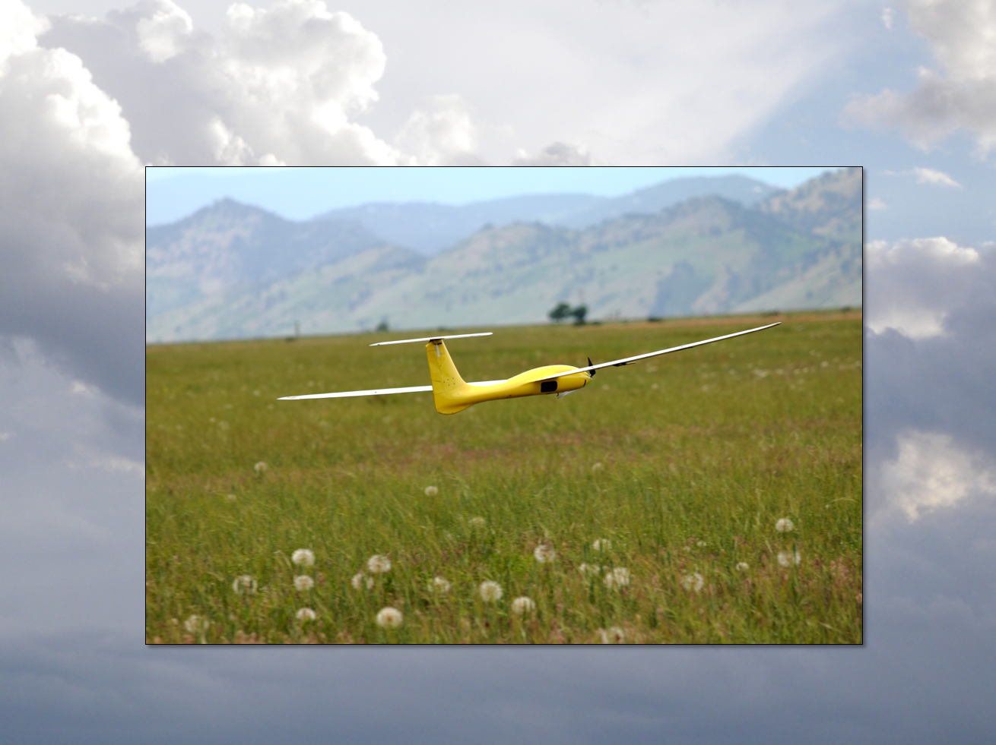
Linearization and Quadrotors
Aircraft Dynamics
UNIVERSITY OF COLORADO BOULDER

Slide 2
Equilibrium and Static Stability
Equilibrium = A steady state that does not change without a disturbance or control action
Usually, the derivatives of the states are zero
Static stability = Consider the equilibrium condition and whether aircraft returns to condition after small perturbation
Dynamic Stability = Details of how a system returns to equilibrium
For aircraft we call the equilibrium condition the “trim condition”
For fixed-wing aircraft the simplest trim condition is
“Steady symmetric flight”
“Straight, level flight”
“Straight, level, unaccelerating flight (SLUF)”
For a quadrotor the simplest trim state is
“Hovering”
“Steady hover”

Slide 3
Trim Condition
In a “hover” equilibrium condition
Subscript 0 denotes trim value
Any constant value

Slide 4
Small Disturbance Theory
In order to analyze aircraft behavior, we will study small variations (disturbances) from a reference condition (with no background wind).
Reference (trim) condition
Small variation
Recall for a quadrotor in steady hover

Slide 5
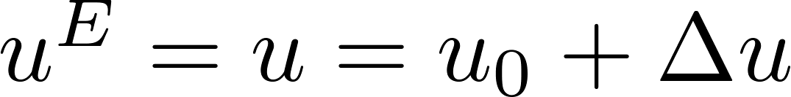
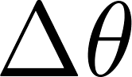
Variations
Can describe variables as reference condition (“trim condition”) plus small variation, e.g

Slide 6
Linearized Control Forces and Moments

Slide 7
Linearized Quadrotor EOM

Slide 8
Linearized Quadrotor EOM
These four variables only depend on one another, and do not influence any other variables

Slide 9
Linearized Quadrotor EOM
Longitudinal
Lateral
Vertical
Spin

Slide 10
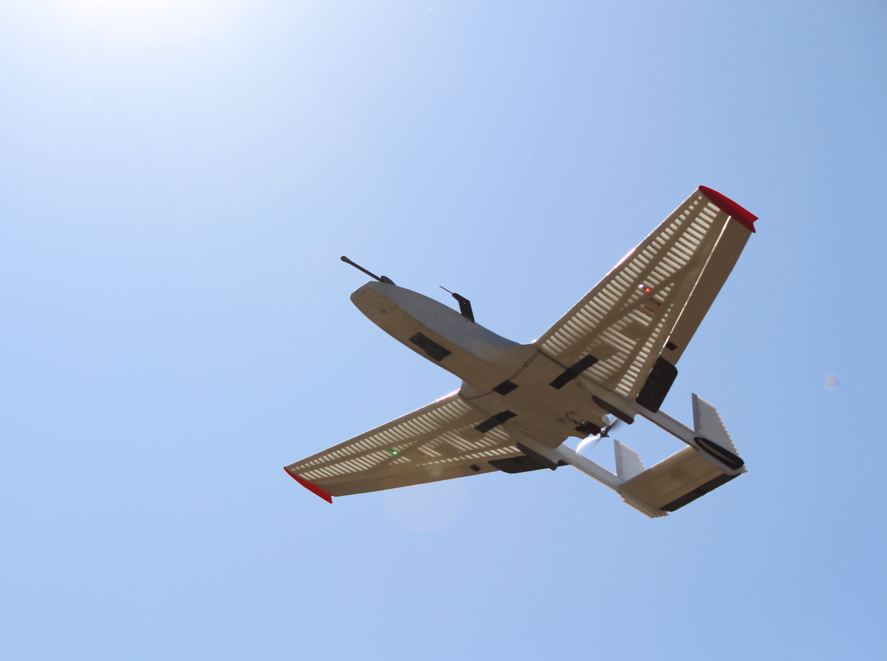
Break

Slide 11
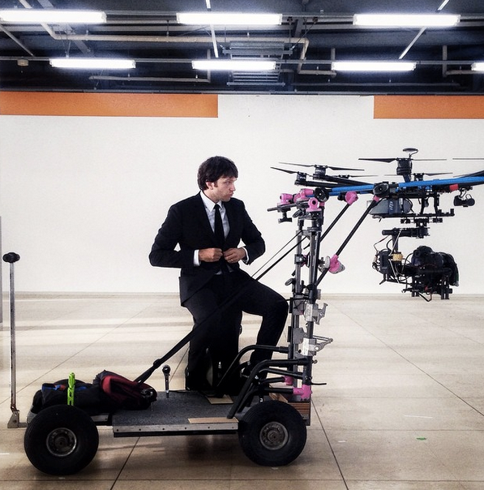
Frew.0
https://www.yout-ube.com/watch?v=u1ZB_rGFyeU

Slide 12
Frew.0
No CGI = All filmed from drone
Everyone moved slowly, filmed at ½ speed and then sped up
Final altitude was about 700 m
https://www.yout-ube.com/watch?v=u1ZB_rGFyeU

Slide 13
Trim Condition
Constant-speed in East (y) direction, yaw zero

Slide 14
Trim EOM

